Slide 1
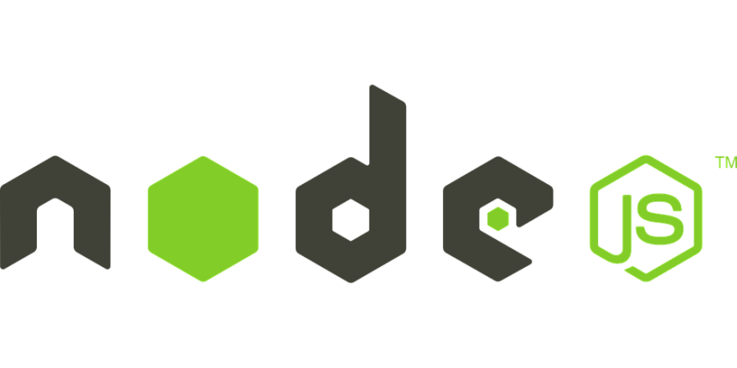
JavaScript on server

Slide 2
What to expect…
Introduction
How node works.
Node cli
Sample http app.
NPM
Node libraries/modules
Intro to express
Sample REST API
Q&A

Slide 3
Background
Node.js is Open Source
Created by Ryan Dahl in 2009
Current version v10.8.0
Node.js is built on Chrome’s v8 engine.

Slide 4
What is node.js?
is for JavaScript running on the server.
is Asynchronous.
is Single Threaded.
is event driven and non Blocking I/O calls.
These makes node extremely fast and efficient.

Slide 5
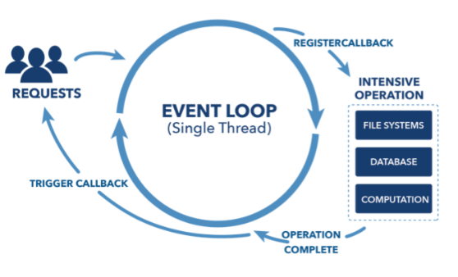
How node.js works?
https://www.youtube.com/watch?v=jOupHNvDIq8

Slide 6
What can we build with node.js?
Rest APIs & Backed Applications
Real-Time Services (Chat, Games .etc)
Blogs, CMS, Social applications.
Utilities and Tools.
So Build anything that is not CPU intensive.

Slide 7
Node in action.
Lets write some code

Slide 8
Node in action
Using CLI
Log to console.
Hello world app.
Using index.js
Simple http server.
Rest end point (without express).

Slide 9
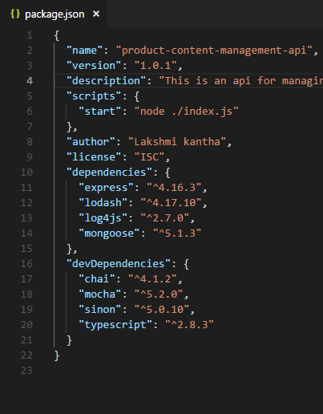
NPM
Node package manager
Bundled with node.
Package.json
Command : npm init

Slide 10
Popular modules
Express - Web development framework.
Mongoose - Wrapper to interact with mongo-db.
Socket.io - Server side component for web-sockets.
Passport- Authentication middleware.
Redis – Redis client library
Pug/Jade – Template engine.

Slide 11
Build Rest API
Using.
Express
Express app
Body parser
Cookie parser
Mongoose
Create DB Connection
Create Schema
Create Model

